Slide 1


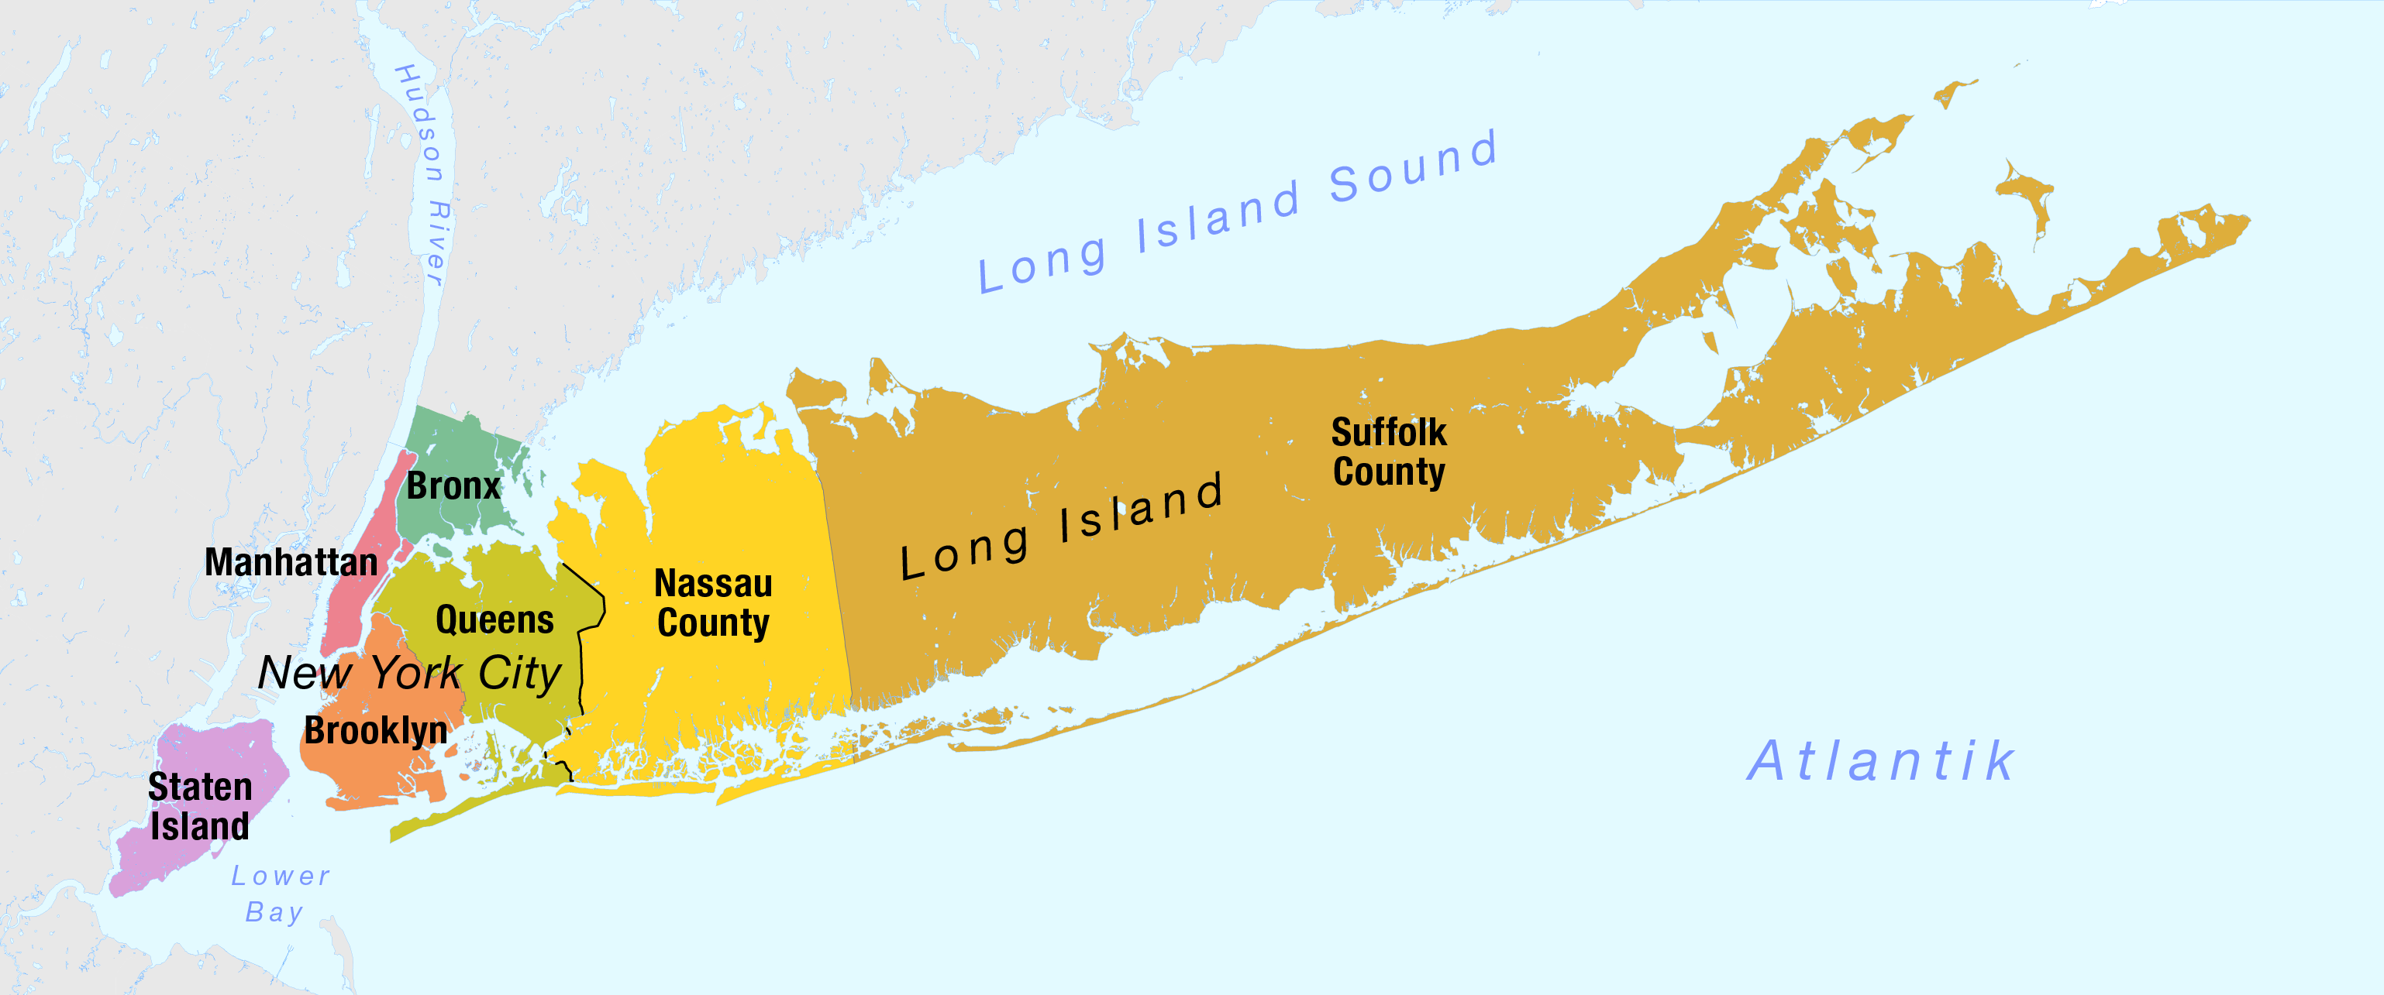
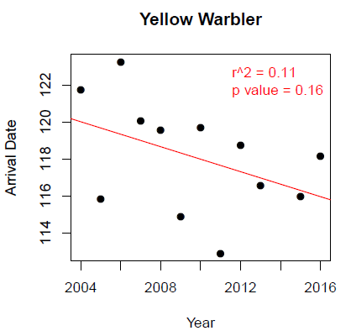
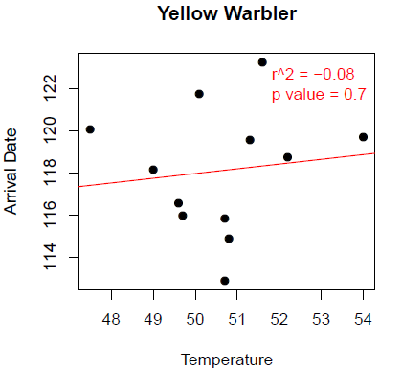
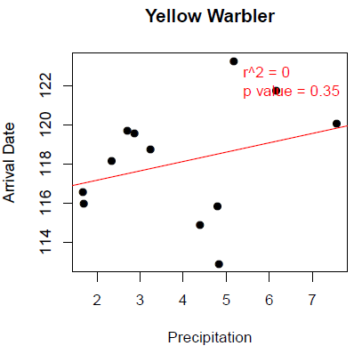
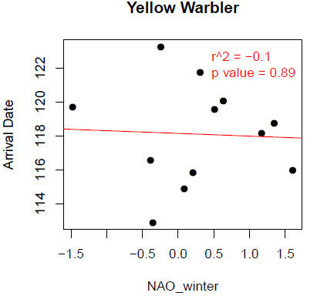


Phenological change in New York City metro area bird populations
Ahmed I, Youngflesh C, Lynch HJ
Stony Brook University, Department of Ecology and Evolution
Environmental
Conclusions
Introduction
Results
Researchers throughout the world have studied the effects that climate change is having on the timing of important biological events (phenology). This timing is critical to ecosystem functionality, as animals must be in sync with their food resources. Rapid climate change can result in an uncoupling in the timing of different components of the ecosystem. (Mayor et al. 2017)
Changes in arrival date over time
What makes our study different from other migration phenology studies
We found that, on average, spring arrival date for migratory birds has advanced 1.4 days per decade.
Spring migration advancement is highly variable. Some species have advanced 20 days per decade while other species are now arriving later.
Various studies have looked at changes in bird phenology around the world (Zelt et al. 2016), however our study provides a targeted analysis of bird phenology specifically in the NYC area.
Given the spatial heterogeneity of climate change (different impacts in different regions), it’s important to conduct analyses in different locales.
However, a robust understanding of phenological change across species is lacking, particularly at a local level.
We sought to investigate whether the timing of bird migration in the NYC area has changed over time and what environmental factors might be related to this change.
Environmental drivers of arrival date
Responses to climate changes in the past 12 years is highly variable depending on the species
Lower AICc values indicate a better fitting model. While models within 2 AICc are considered to be equivalent (Burnham and Anderson 2003), there was one clear ‘best’ model.
Precipitation was found to be the strongest driver of arrival date according to our model selection analysis.
Changes in bird phenology varies widely among species which makes broad generalizations difficult.
Future studies should explore more deeply the drivers of phenology in individual species.
Differing rates of phenological change could mean that some species will exhibit larger ‘mismatches’ with food resources than others.
We used AIC (model selection) to determine which environmental factor was most strongly associated with spring arrival. All analyses were conducted in R (R Core Team 2017).
Methods
DATA
We used the citizen science database eBird, to measure changes in the spring arrival date of 43 migratory bird species from 2004 to 2016. We used data from the New York City Metro Area.
Best fitting models for arrival date
Model | AICc | dAICc
Arrival Date ~ Temperature | 2810 | 23
Arrival Date ~ Precipitation | 2787 | 0
Arrival Date ~ NAO | 2811 | 24
Statistical Methods
We used linear mixed models to investigate: 1) changes in spring arrival over time and 2) the relationship between spring arrival and environmental
Yellow Warbler
factors (average March Precipitation, average March temperature, and the North Atlantic Oscillation Index [NAO]).
114 116 118 120 122
We used AICc (model selection) to determine which environmental factor was most strongly associated with spring arrival. All analyses were conducted in R (R Core Team 2017).
Arrival Date
We found that precipitation was the best predictor for arrival date, not temperature.
We initially expected that temperature would the main factor in determining migration patterns. We show that many aspects of climate change may be influencing bird phenology
Full model:
Arrival Date ~ Precipitation + Temperature + NAO
2004 2008 2012 2016
48 50 52 54
Temperature
3 4 5 6 7
Precipitation
-1.5 -1 -0.5 0 0.5 1 1.5
NAO
Year
Lit Cited
Acknowledgements
Additional information
Burnham, KP, and DR Anderson. Model selection and multimodel inference: a practical information-theoretic approach. (2013). Springer Science & Business Media.
R Core Team. R: a language and environment for statistical computing. R Foundation for Statistical Computing (2016).
Zelt J, RL Deleon, A Arab, K Laurent, and JW Snodgrass. Long-Term Trends In Avian Migration Timing For the State of New York. (2016). Wilson Journal of Ornithology 129: 271-282.
Mayor SJ, RP Guralnick, MW Tingley, J Otegui, JC Withey, SC Elmendorf, ME Andrew, S Leyk, IS Pearse, and DC Schneider. Increasing phenological asynchrony between spring green-up and arrival of migratory birds. (2017). Scientific Reports 7.
EMAIL:
Iftikar.ahmed@stonybrook.edu

